Slide 1

NSG Pilkington – University of Liverpool Machine Learning Project: 21/04/2021
Dr. Peter Green
Diego Echeverria
Sarini Jayasinghe
Risk Institute,
School of Engineering

Slide 2
Today
Videos
Clustering MK4 data
Combined signals
Time lag estimates
Future work

Slide 3
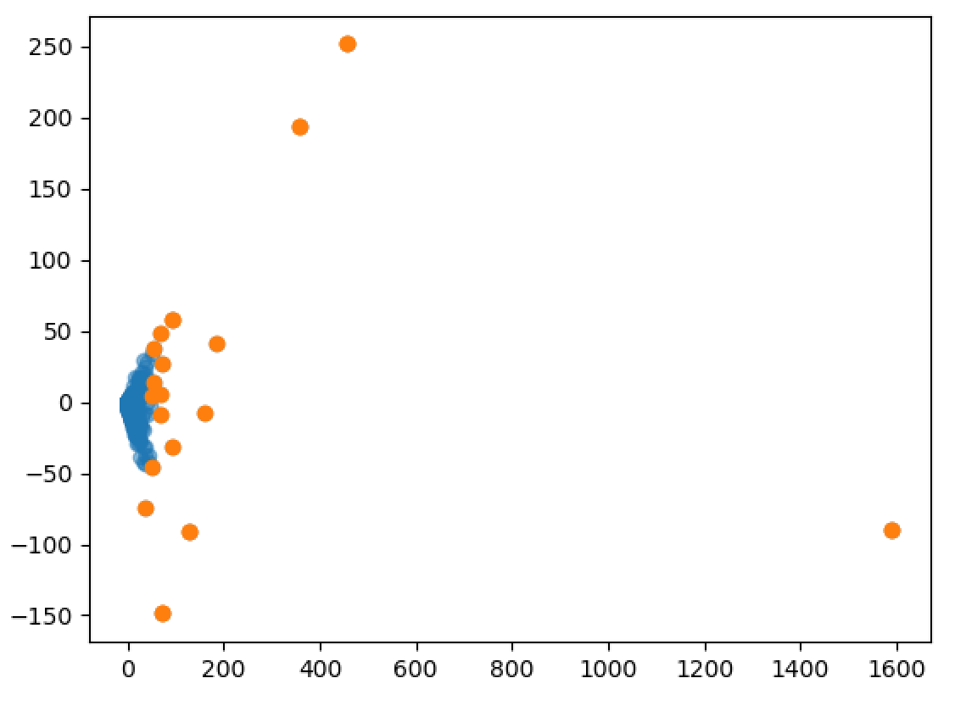
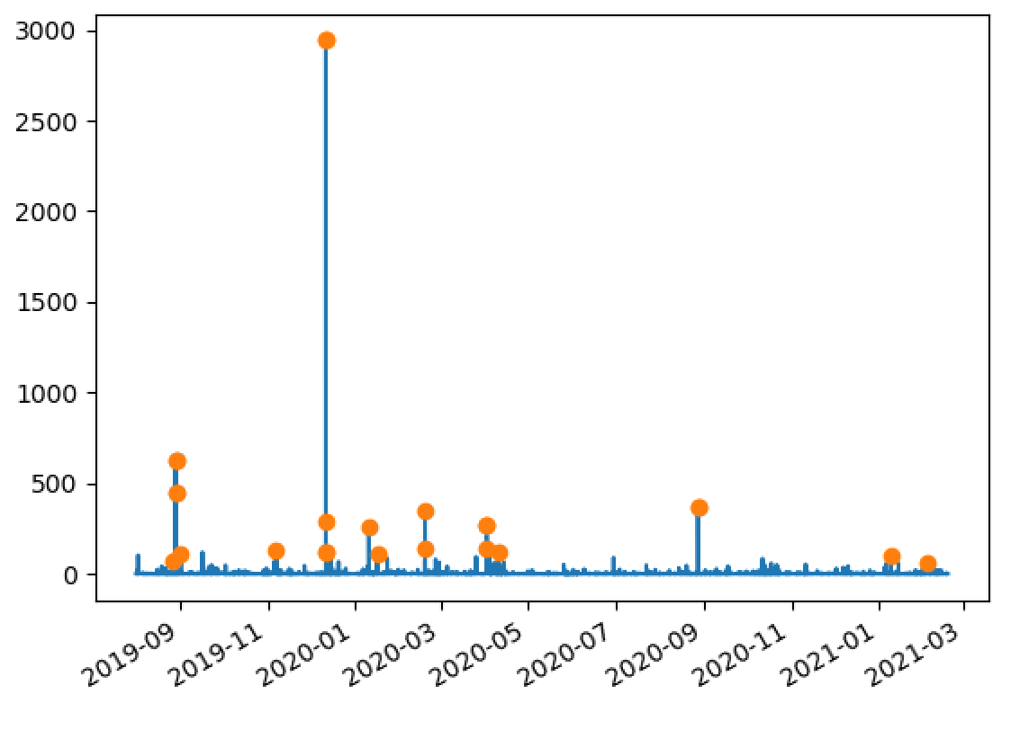
MK4 Fault Data
Removed the columns 'DateTime', 'Area', 'TotalFaults', 'ProductID’, and ‘Product’.
Removed 'Class1Faults’ and 'Module0Faults’ as they only contained zeros.

Slide 4
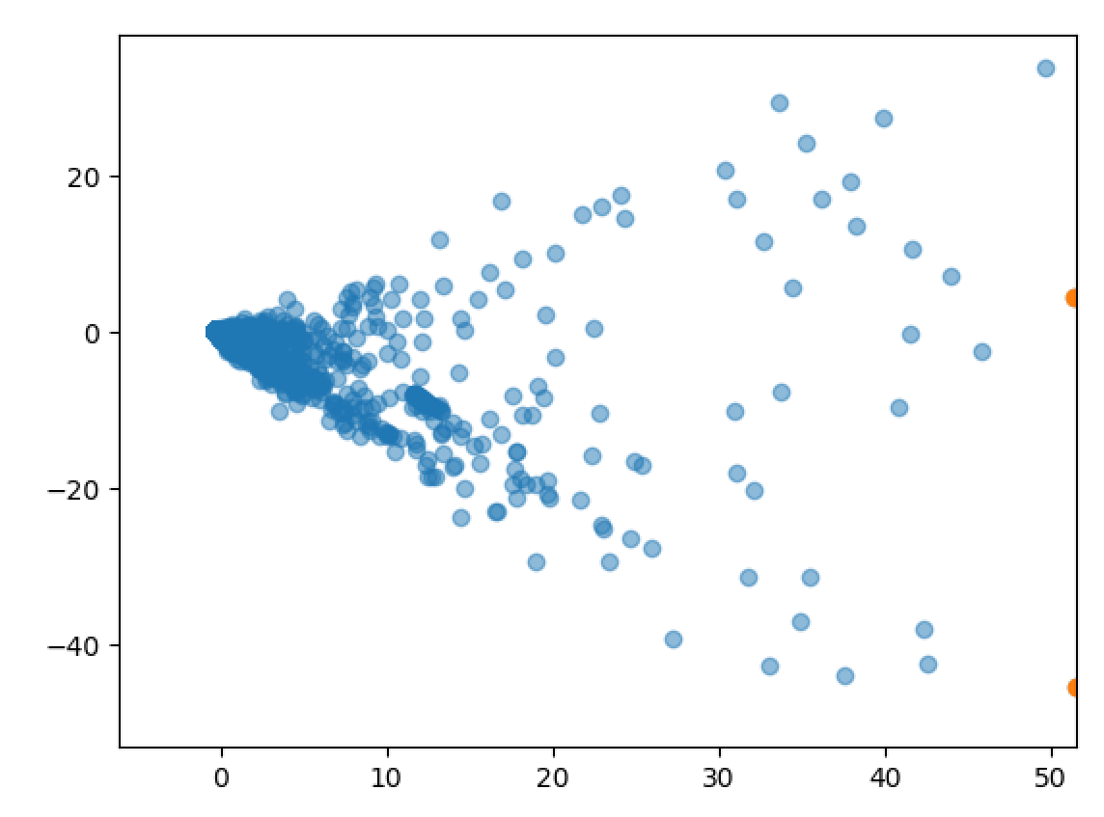
MK4 Fault Data
Removed the columns 'DateTime', 'Area', 'TotalFaults', 'ProductID’, and ‘Product’.
Removed 'Class1Faults’ and 'Module0Faults’ as they only contained zeros.

Slide 5
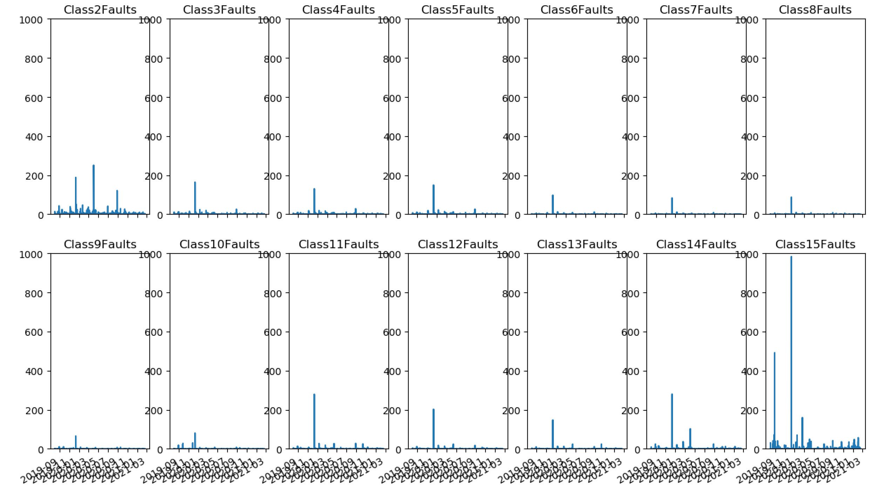
MK4 Fault Data
Now focusing only on ‘Class Faults’.
(Same y axes)

Slide 6
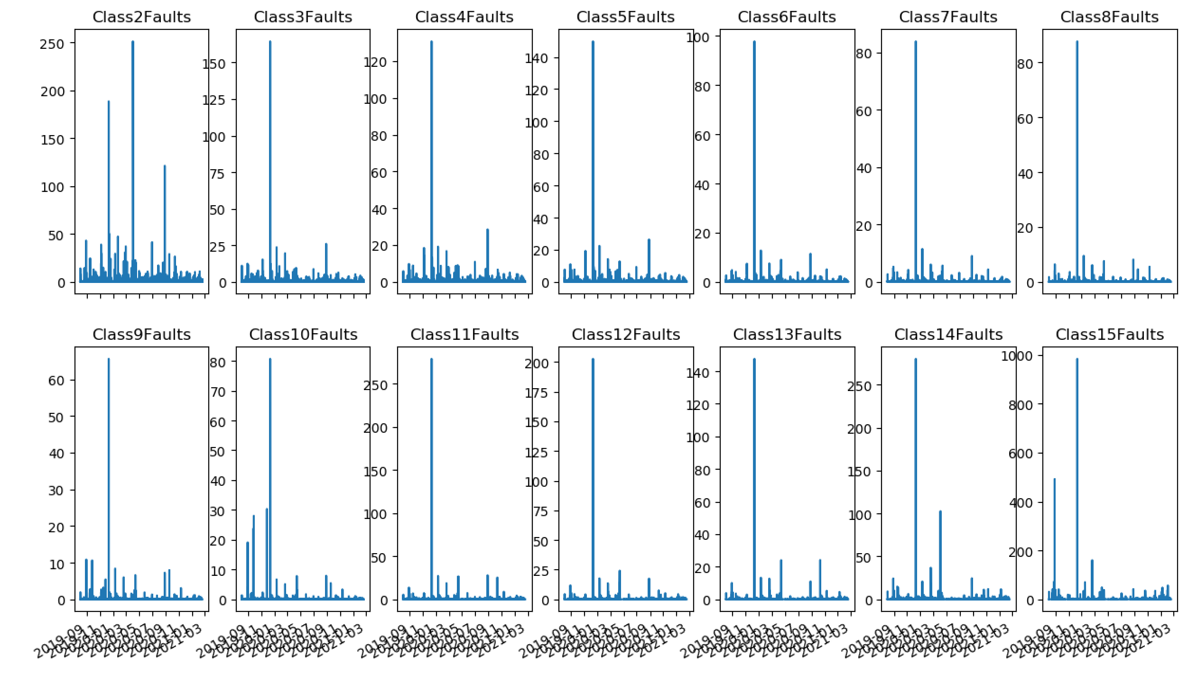
MK4 Fault Data
Now focusing only on ‘Class Faults’.
(Auto y axes)

Slide 7
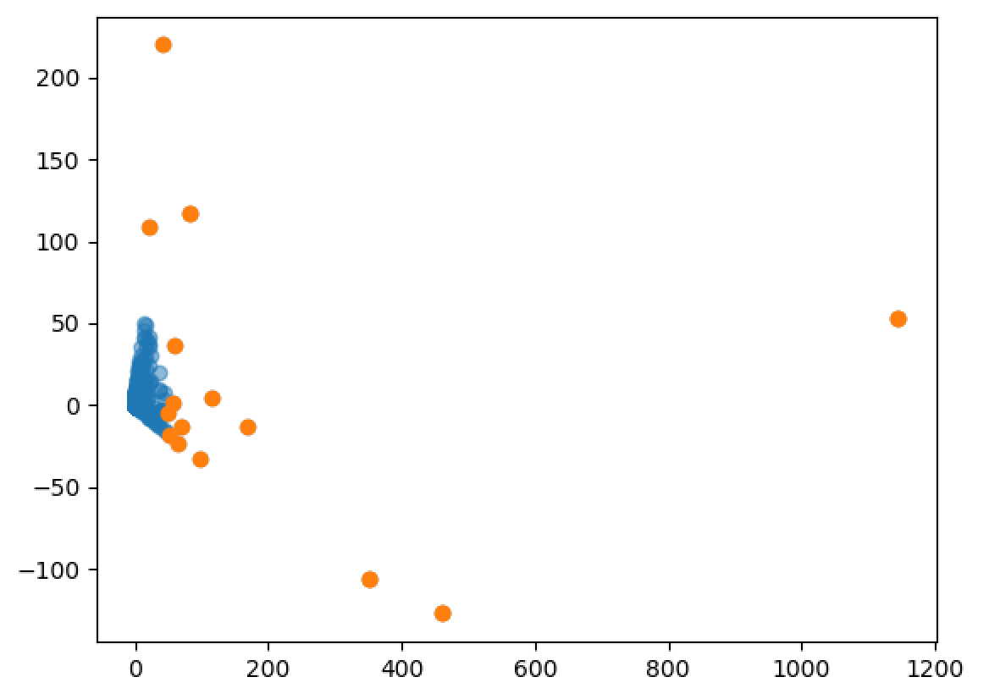
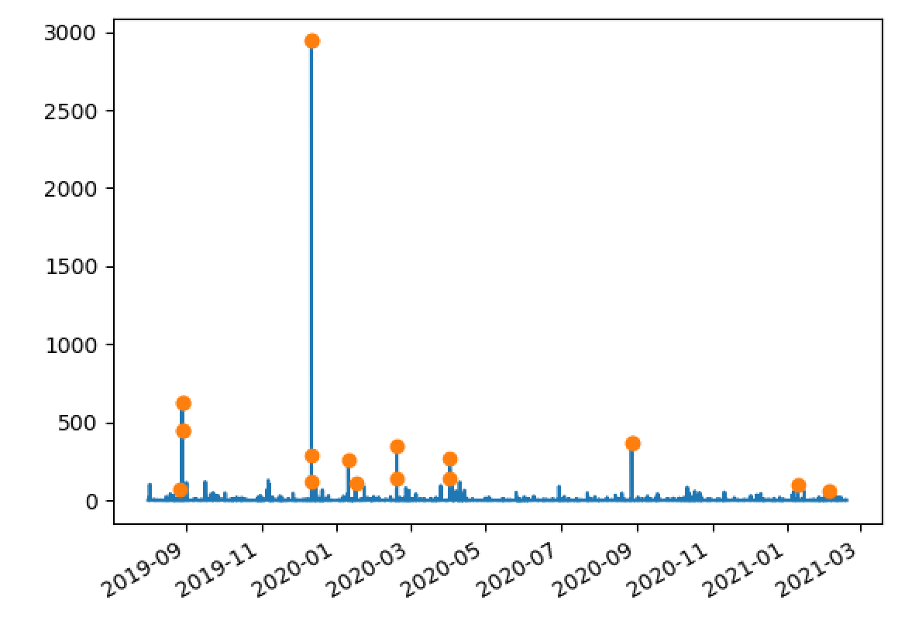
MK4 Fault Data
Now focusing only on ‘Class Faults’.

Slide 8
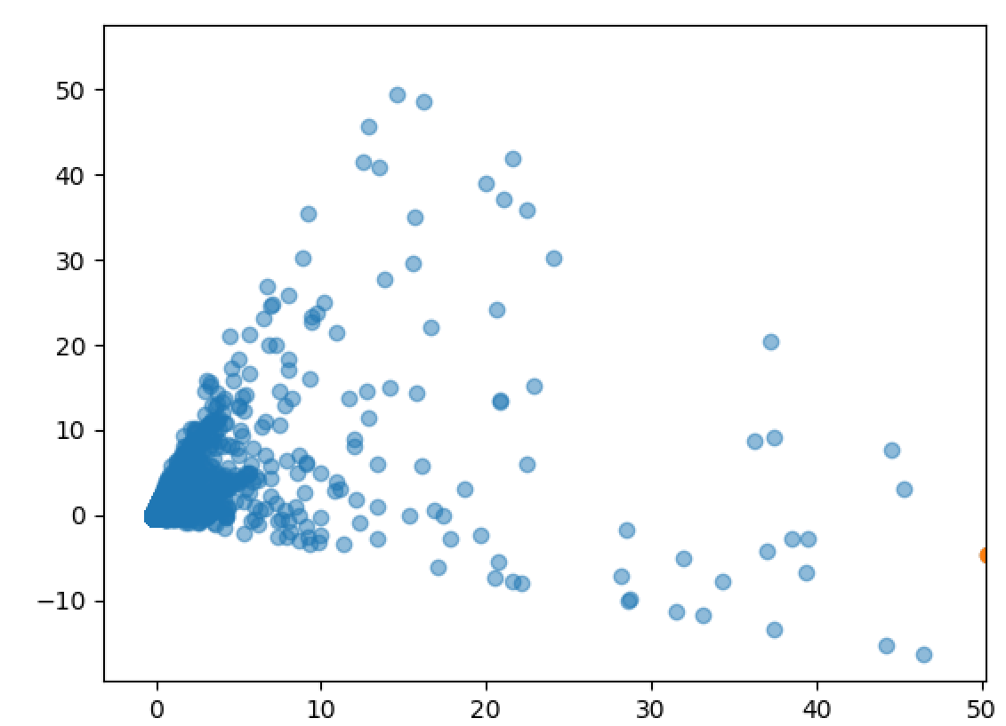
MK4 Fault Data
Now focusing only on ‘Class Faults’.

Slide 9
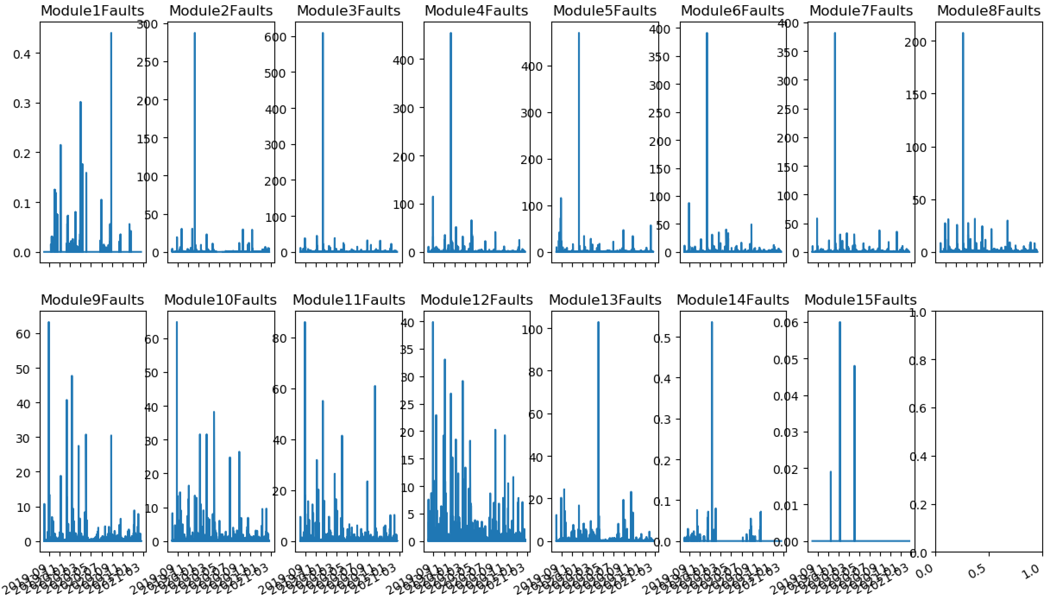
MK4 Fault Data
Now focusing only on ‘Module Faults’.

Slide 10
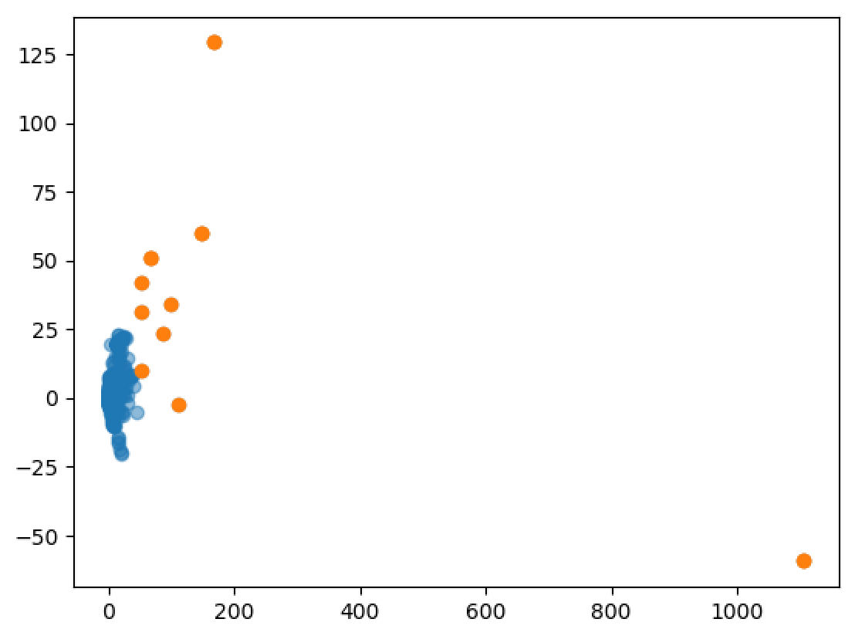
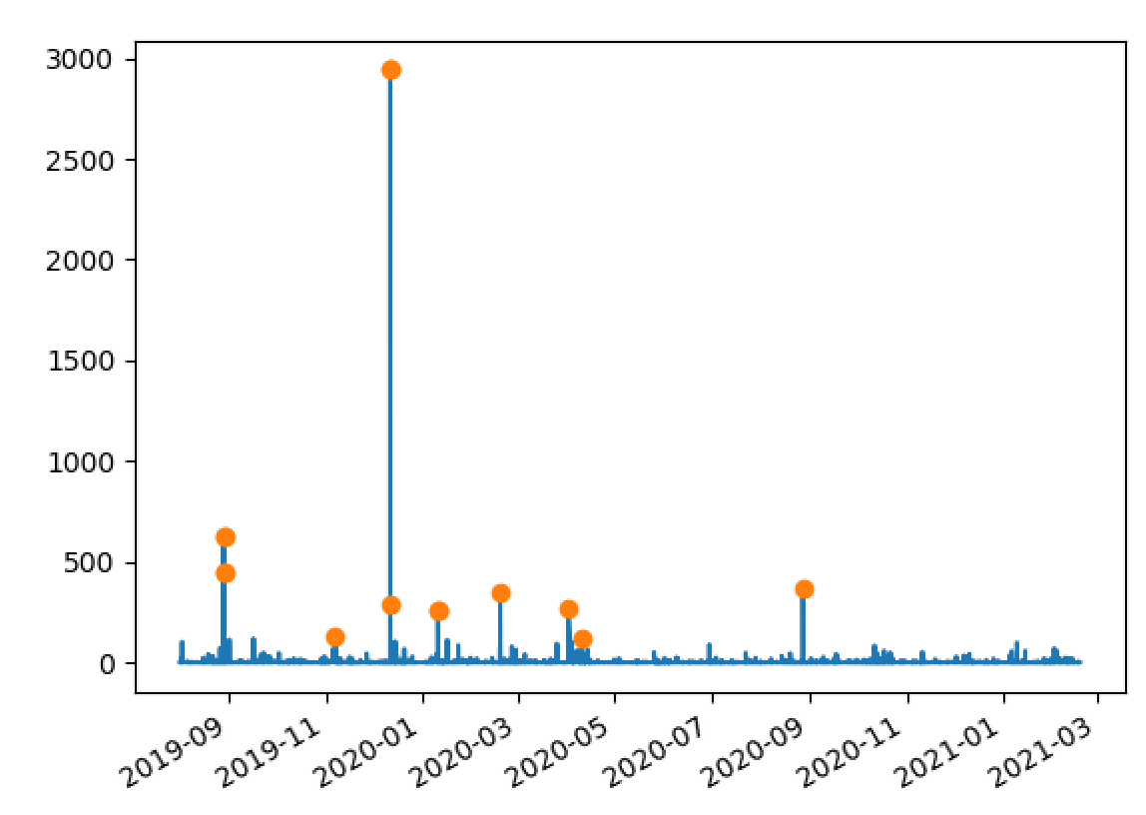
MK4 Fault Data
Now focusing only on ‘Module Faults’.

Slide 11
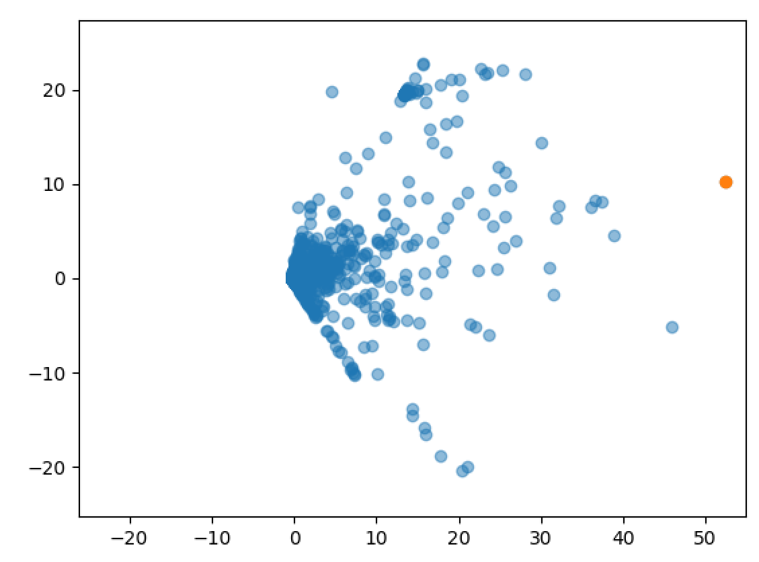
MK4 Fault Data
Now focusing only on ‘Module Faults’.

Slide 12
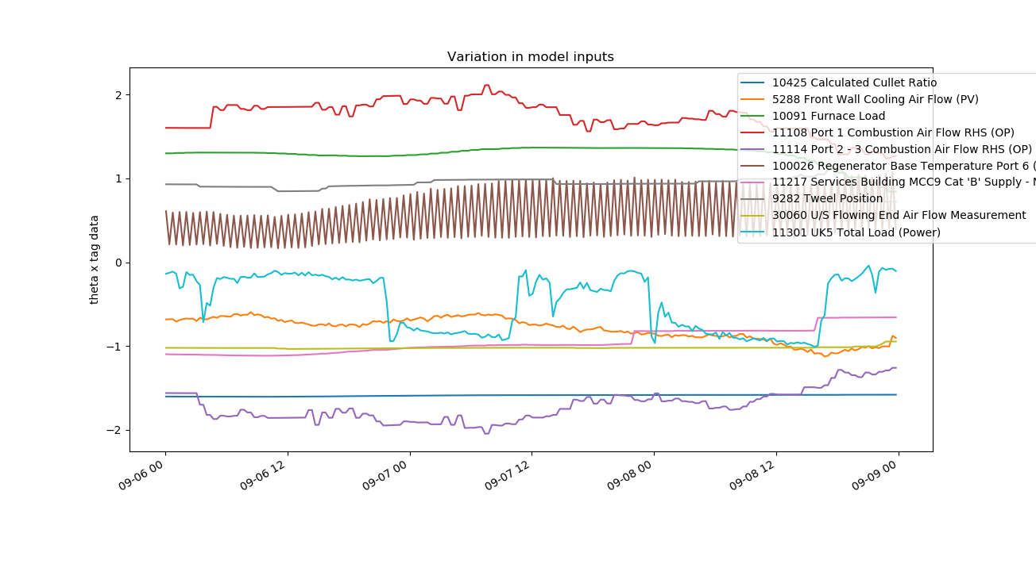
100026 Regenerator Base Temperature Port 6 (combined)
Tag 100026 is a combined signal from 7594 Regenerator Base Temperature Port 6 LHS and 7598 Regenerator Base Temperature Port 6 RHS.

Slide 13
100026 Regenerator Base Temperature Port 6 (combined)
Tag 100026 is a combined signal from 7594 Regenerator Base Temperature Port 6 LHS and 7598 Regenerator Base Temperature Port 6 RHS.
As indicated in the spreadsheet ‘UK5 AI Furnace Model Input Pre-Processing’, tags 7594 and 7598 have been applied the reversals strategy and then both signals have been combined.

Slide 14
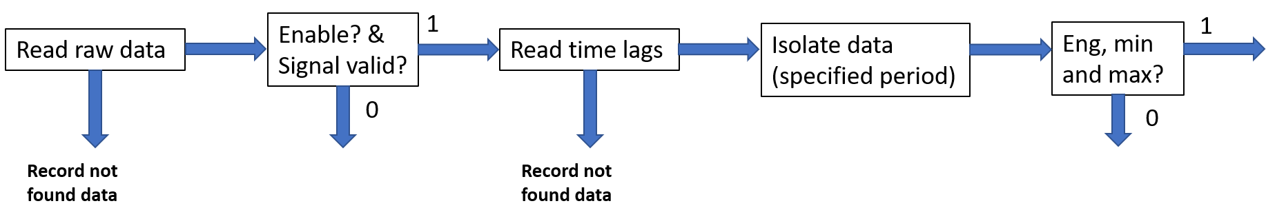
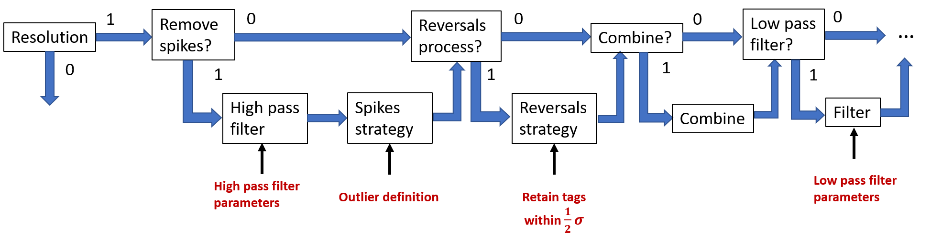
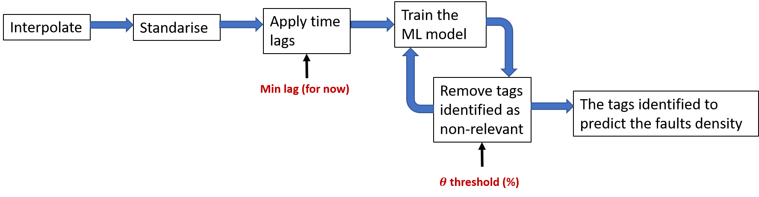
Application pipeline
Pre-processing pipeline

Slide 15
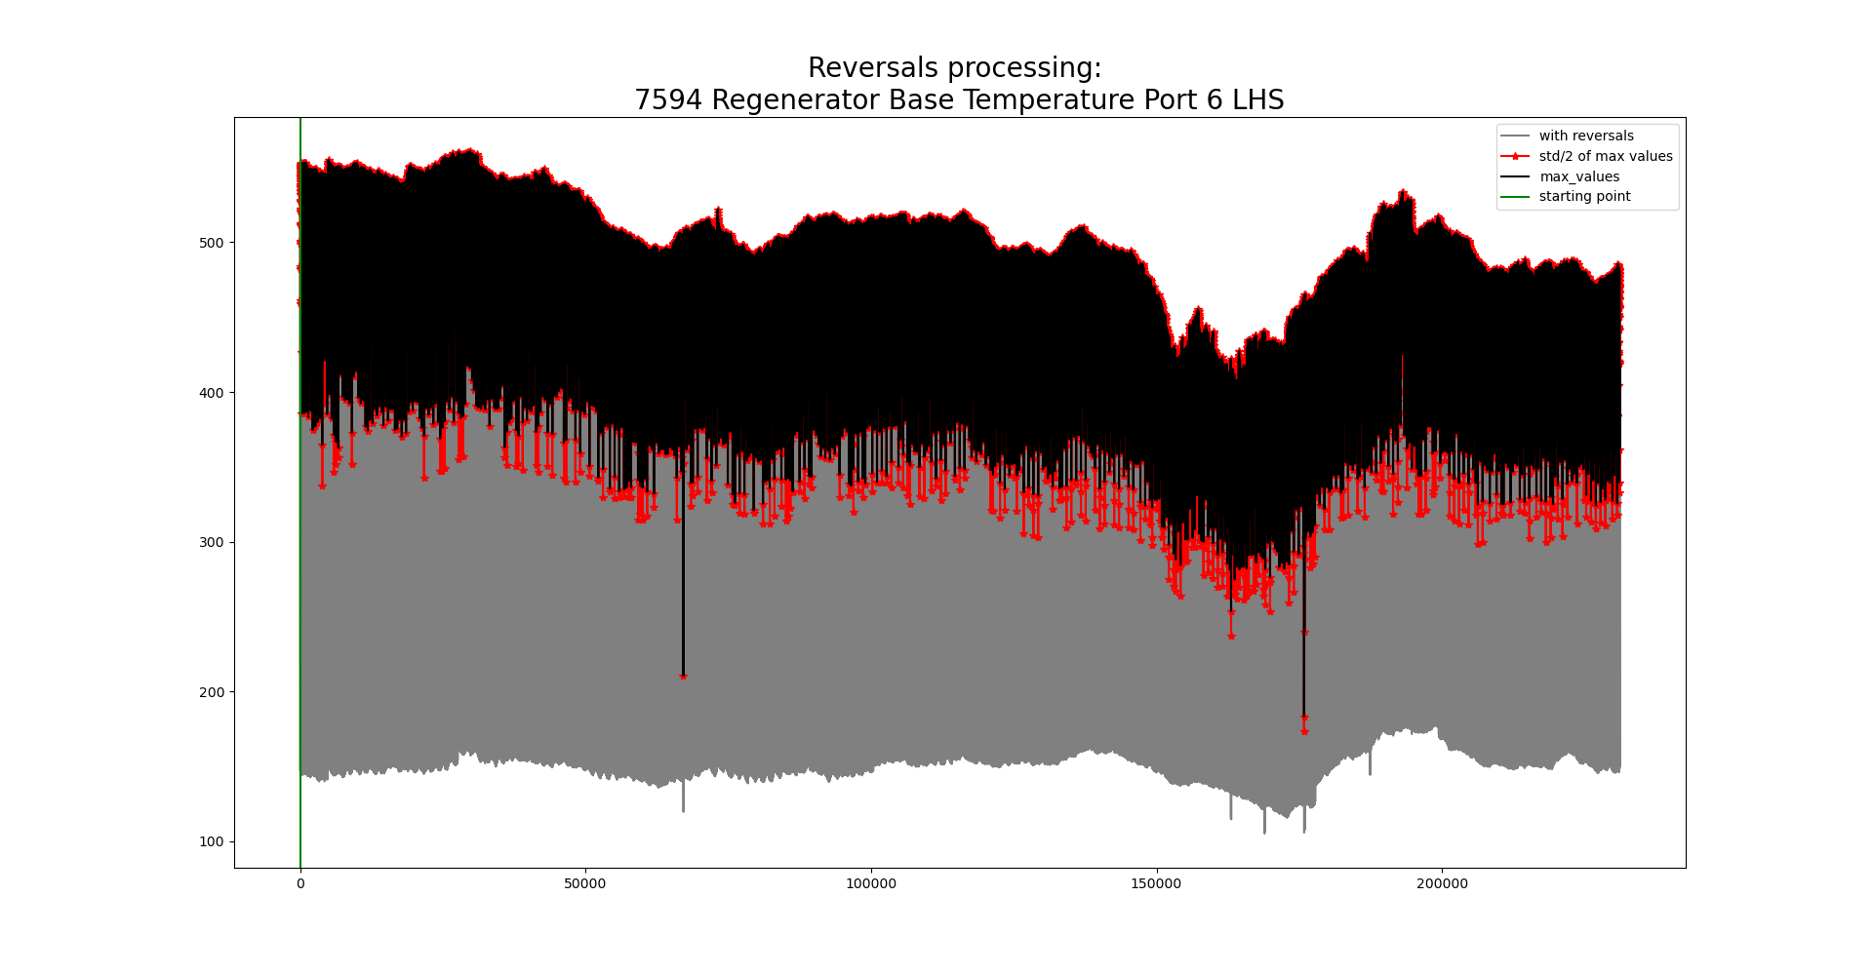
100026 Regenerator Base Temperature Port 6 (combined)

Slide 16
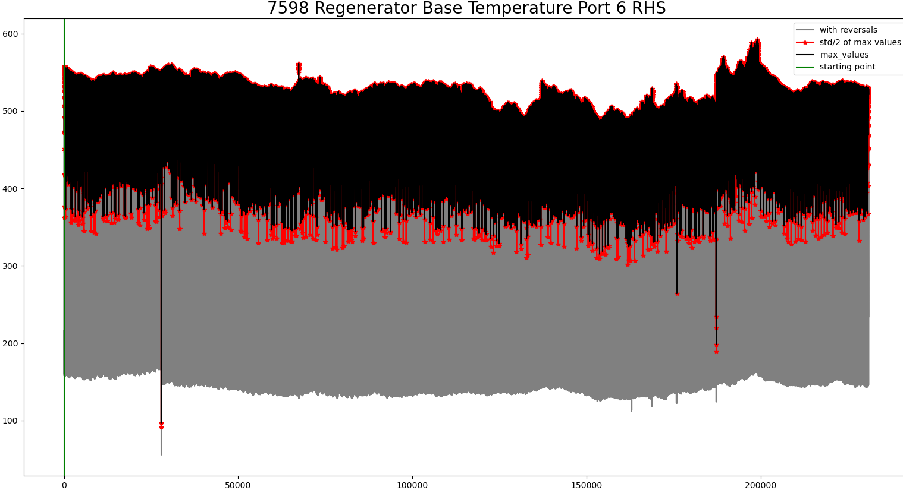
100026 Regenerator Base Temperature Port 6 (combined)

Slide 17
100026 Regenerator Base Temperature Port 6 (combined)

Slide 18
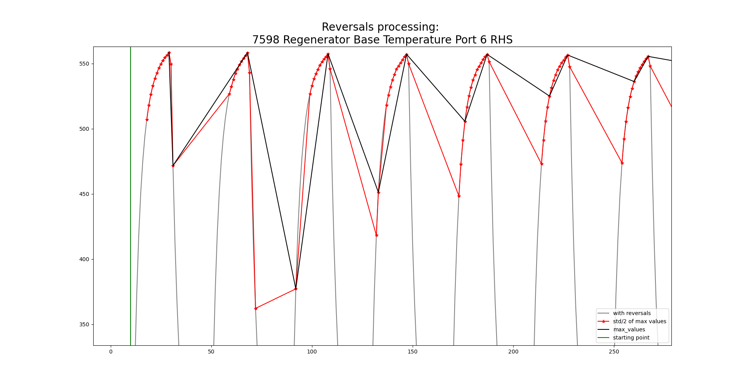
100026 Regenerator Base Temperature Port 6 (combined)

Slide 19

100026 Regenerator Base Temperature Port 6 (combined)
Search for the minimum value of the signal at the first 20 minutes to identify the point before the next firing.
Identify the maximum value within a 20-minute time period.
Get the signal values within $σ/2$ around the maximum value.
where $σ$ is the standard deviation of the current 20 minutes of the raw signal

Slide 20
Application pipeline
Pre-processing pipeline

Slide 21
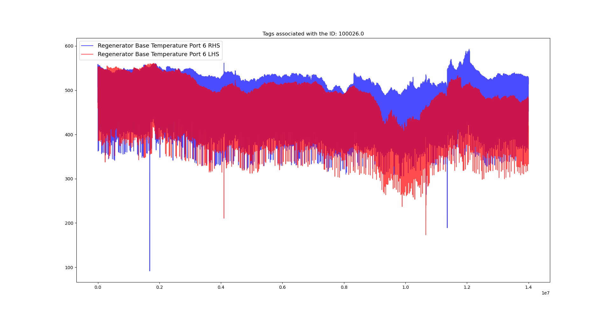
100026 Regenerator Base Temperature Port 6 (combined)

Slide 22
100026 Regenerator Base Temperature Port 6 (combined)

Slide 23
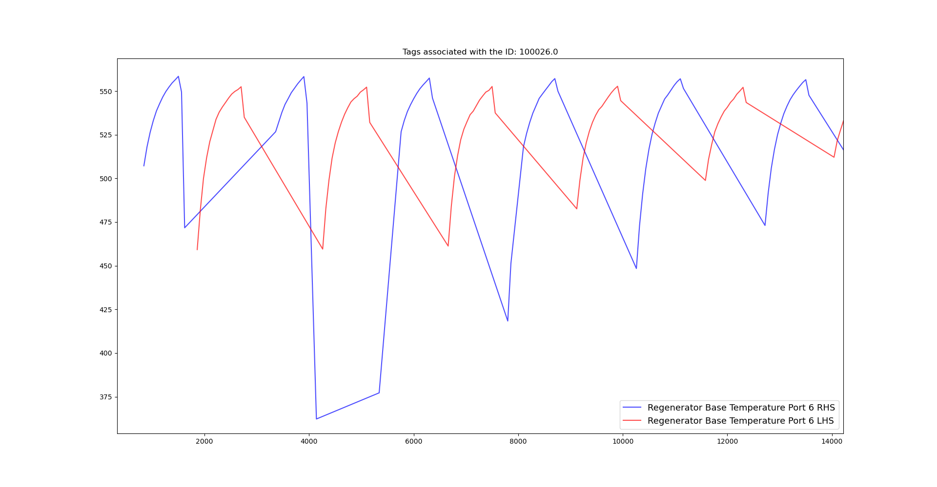
100026 Regenerator Base Temperature Port 6 (combined)

Slide 24
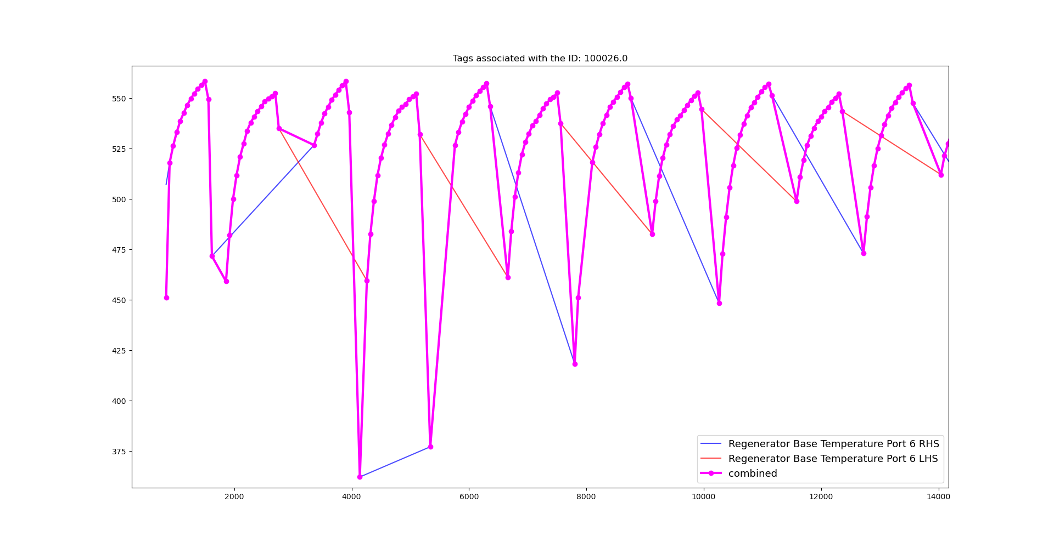
100026 Regenerator Base Temperature Port 6 (combined)

Slide 25
100026 Regenerator Base Temperature Port 6 (combined)
Tag 100026 is a combined signal from 7594 Regenerator Base Temperature Port 6 LHS and 7598 Regenerator Base Temperature Port 6 RHS.
As indicated in the spreadsheet ‘UK5 AI Furnace Model Input Pre-Processing’, tags 7594 and 7598 have been applied the reversals strategy and then both signals have been combined.
We decided not to filter the combined signal, as we agreed that it is formed by real values.

Slide 26
Application pipeline
Pre-processing pipeline

Slide 27
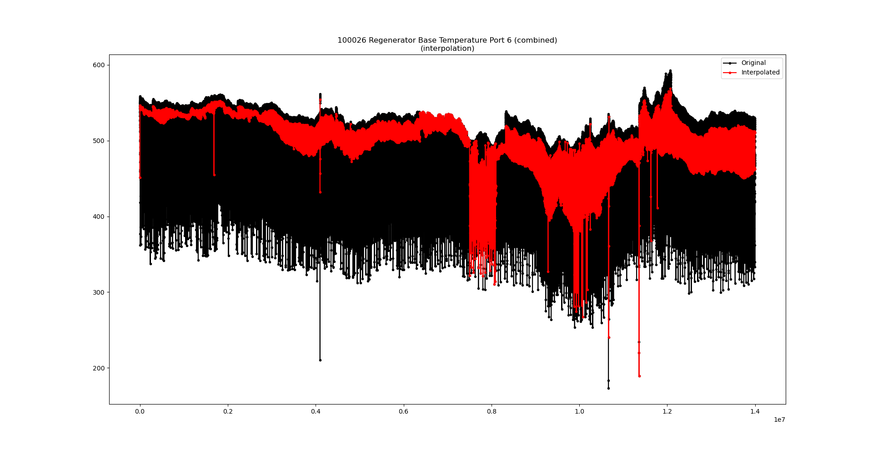
100026 Regenerator Base Temperature Port 6 (combined)

Slide 28
100026 Regenerator Base Temperature Port 6 (combined)

Slide 29
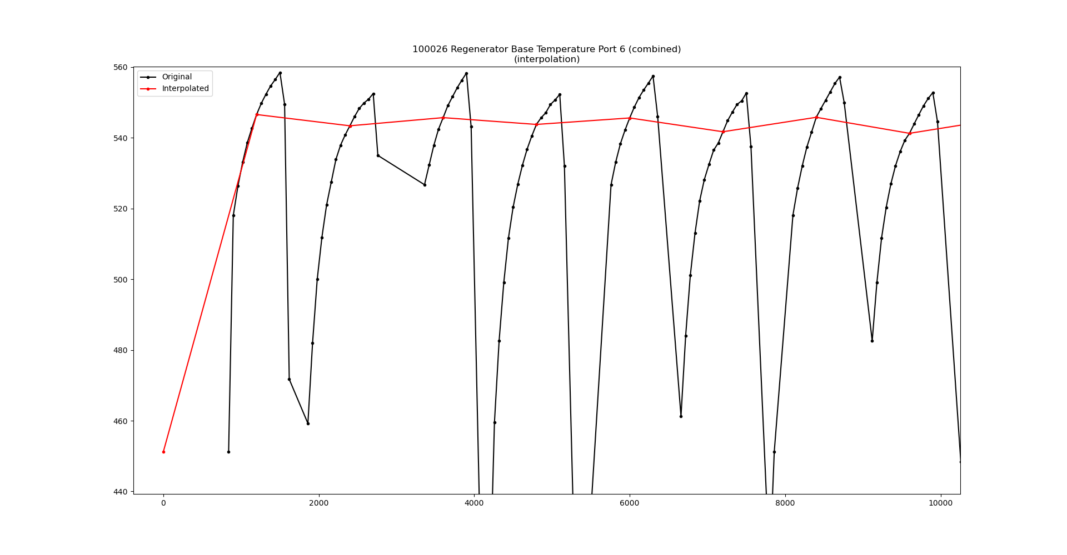
100026 Regenerator Base Temperature Port 6 (combined)

Slide 30
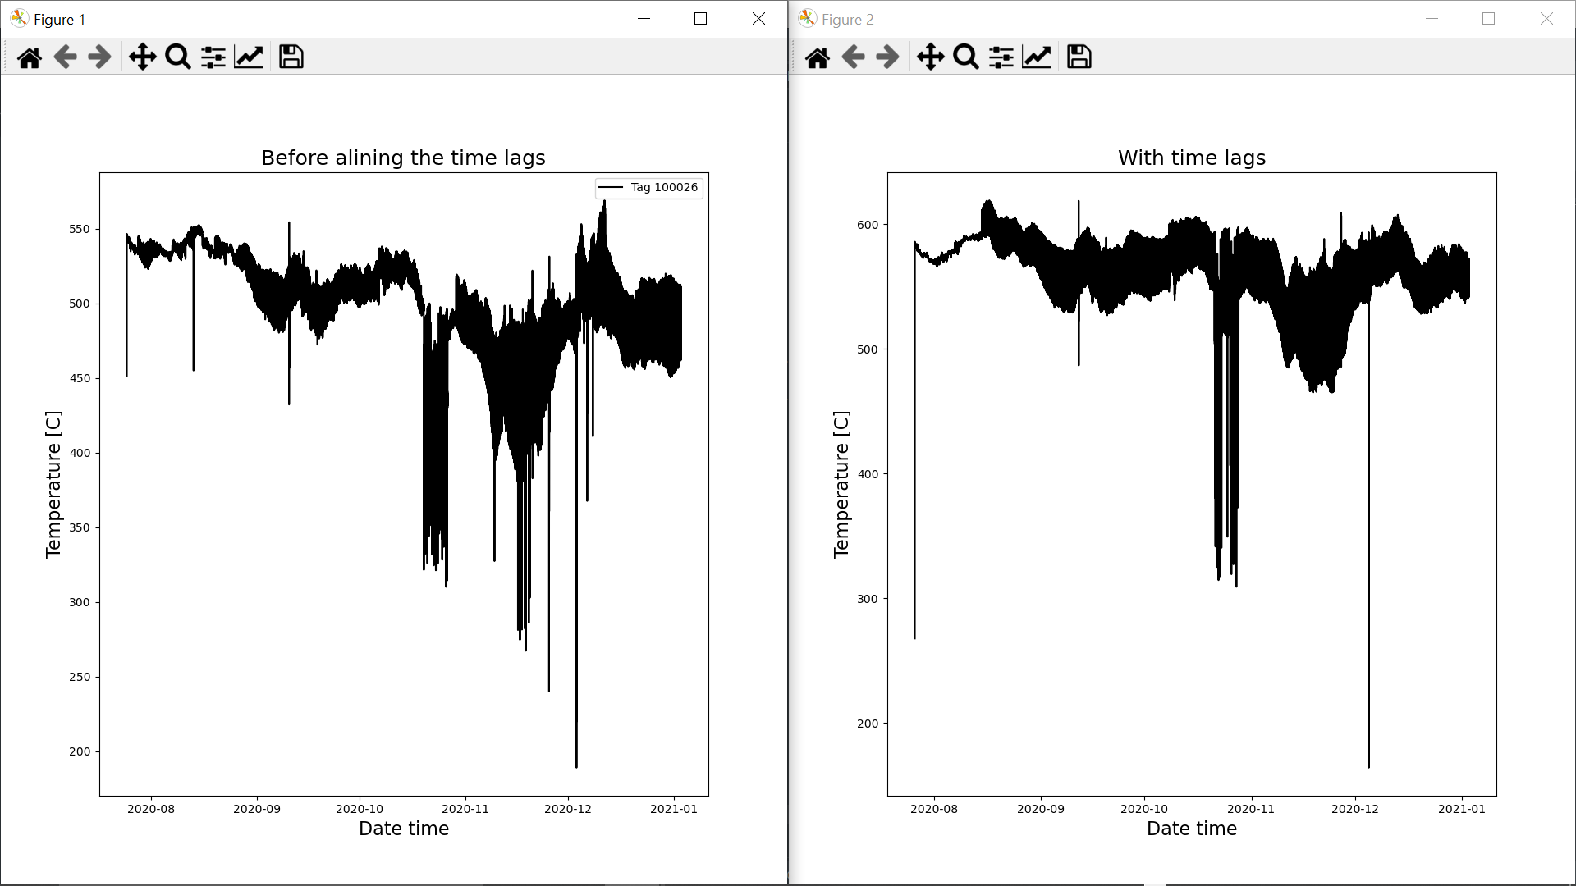
100026 Regenerator Base Temperature Port 6 (combined)

Slide 31
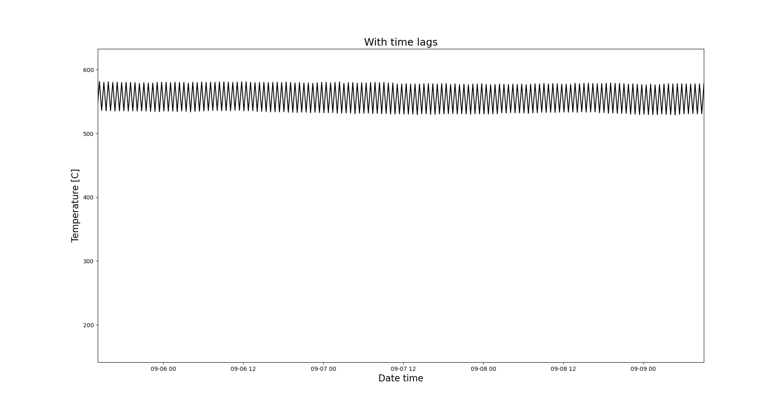
100026 Regenerator Base Temperature Port 6 (combined)
Tag 100026 is a combined signal from 7594 Regenerator Base Temperature Port 6 LHS and 7598 Regenerator Base Temperature Port 6 RHS.
Pre-processed signal

Slide 32

Time lags estimation
We have run 5000 simulations where a Linear Regression (LR) model has been evaluated at observation points (N = 11620) with random time lags.
The random time lags have been obtained from a Uniform distribution, with a lower bound equal to the time lags provided by NSG Pilkington and the upper bound equal to,
$$Upper Bound=Lower Bound+60 hours$$
Such that,
$$random time lags∼U(Lower bound, Upper bound)$$
This allows us to get a maximum time lag of 4 days for the tags that have been assigned (by NSG Pilkington) with the maximum time lag (in this case 36 hours).
The time lag configuration that provided the lowest Mean Square Error has been chosen.

Slide 33
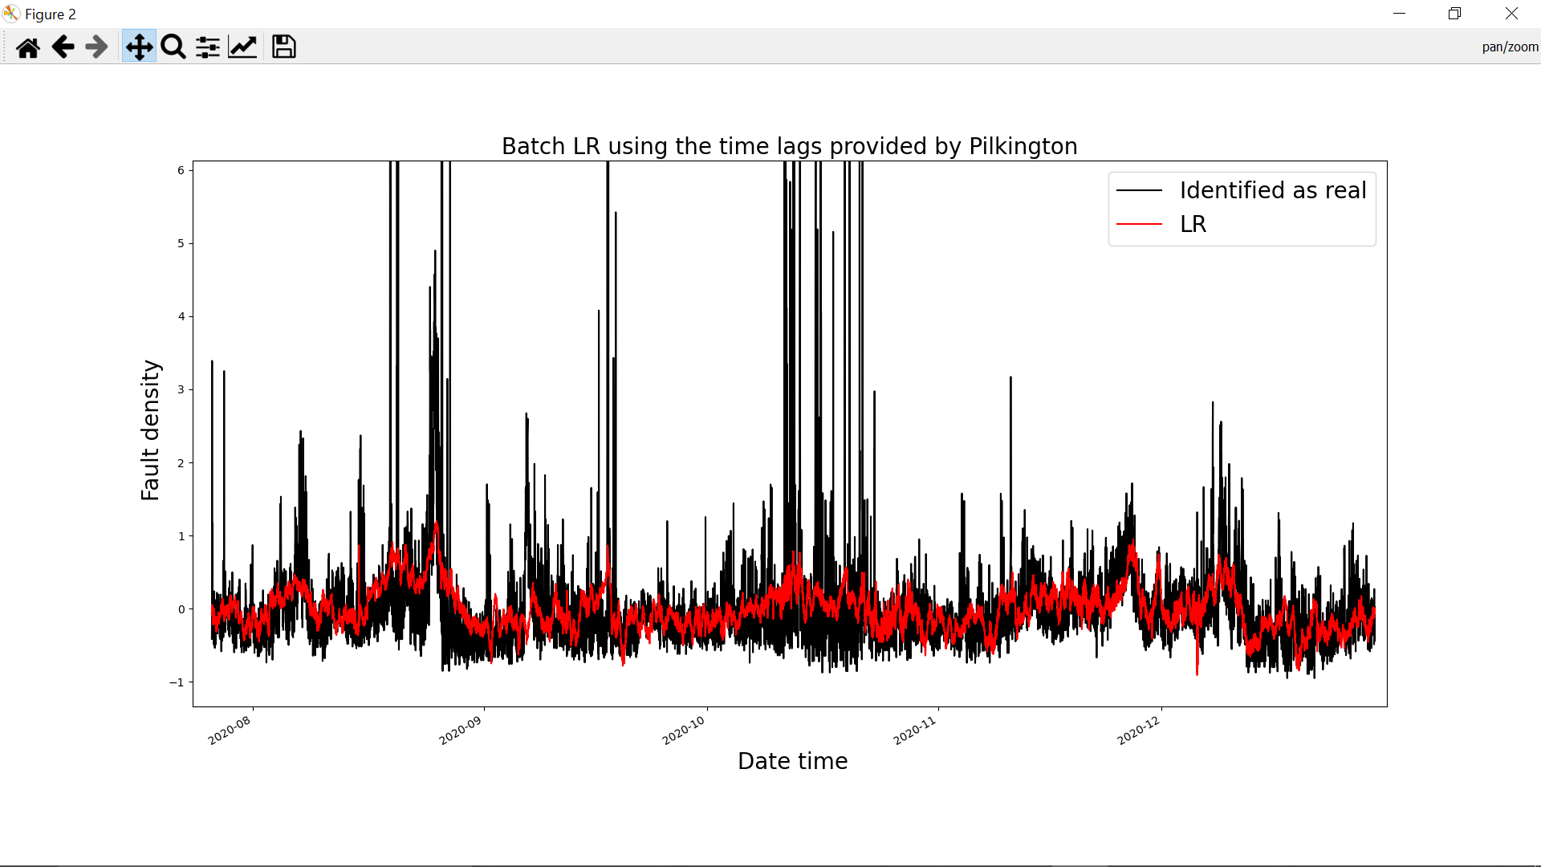
Time lags estimation
The following plot shows the results of the LR model using the tags at the estimated time lags and evaluated at observed points (N = 11620)

Slide 34
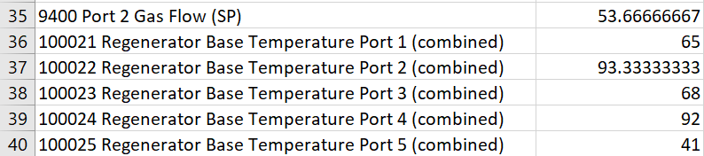
Time lags estimation
Some remarks of the regression performance with the estimated time lags,
1) The Linear Regression model now predicts only positive values of fault density.
2) The very slow trend has been captured.
3) Still struggles to follow the increases mentioned in the files UK5_FD1 and UK5_FD2
Some values of the estimated time lags

Slide 35
Future Work
What else can we do to help with the fault density problem?
Looks like there is scope for improving the combined signals?
Linear Dynamical System focuses on predictive uncertainty – is this the correct question? Should the question be: within what ranges do the furnace properties need to stay?

Slide 36
Thank you for your attention. ANY QUESTIONS?

